Slide 1

Real-time face recognition
AI&DS
- Under the guidance of Dr. Figlu Mohanty

Slide 2
Team members:
G. Sri Vardhan Reddy – 2110030217
A. Jyothi Swaroop - 2110030209
R. Satya Sai - 2110030256
V. Yeshwanth Sai - 2110030216
CH. Dileep Reddy – 2110030307

Slide 3
Problem Statement:
Real-time face recognition is a powerful technology, but it also presents a number of challenges that need to be addressed.
In order for organizations to take full advantage of this technology, they must have a comprehensive understanding of its potential as well as the potential risks and limitations.

Slide 4
Literature Survey:
"Real-time Face Recognition: An Overview" by J.C. Chen et al. (IEEE Transactions on Pattern Analysis and Machine Intelligence, 2018). This paper provides a comprehensive overview of real-time face recognition algorithms and systems.
"Real-time Face Detection and Recognition using OpenCV" by A. Rajkumar et al. (International Journal of Computer Applications, 2015). This paper presents an approach to real-time face detection and recognition using OpenCV and Eigenfaces

Slide 5
Data Set Collection:
Labeled Faces in the Wild (LFW): A database of face photographs with more than 13,000 images of over 5,000 people. This is a popular datasets used for bench marking face recognition algorithms.
Face Scrub: A datasets of over 100,000 face images of 530 people, with each person having at least 20 images. This datasets includes both frontal and profile images of faces.
CelebA: A large-scale face recognition datasets with more than 200,000 celebrity images. The images in this datasets are aligned and have been annotated with facial landmarks.

Slide 6
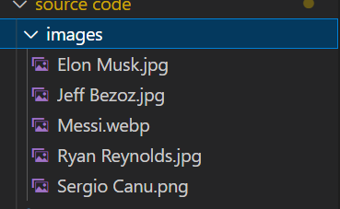
Present dataset:
We have collected a sample from the main set of images, which is to be used in the main prototype.
Simple one image or a two, for each personality to be tested is taken.

Slide 7
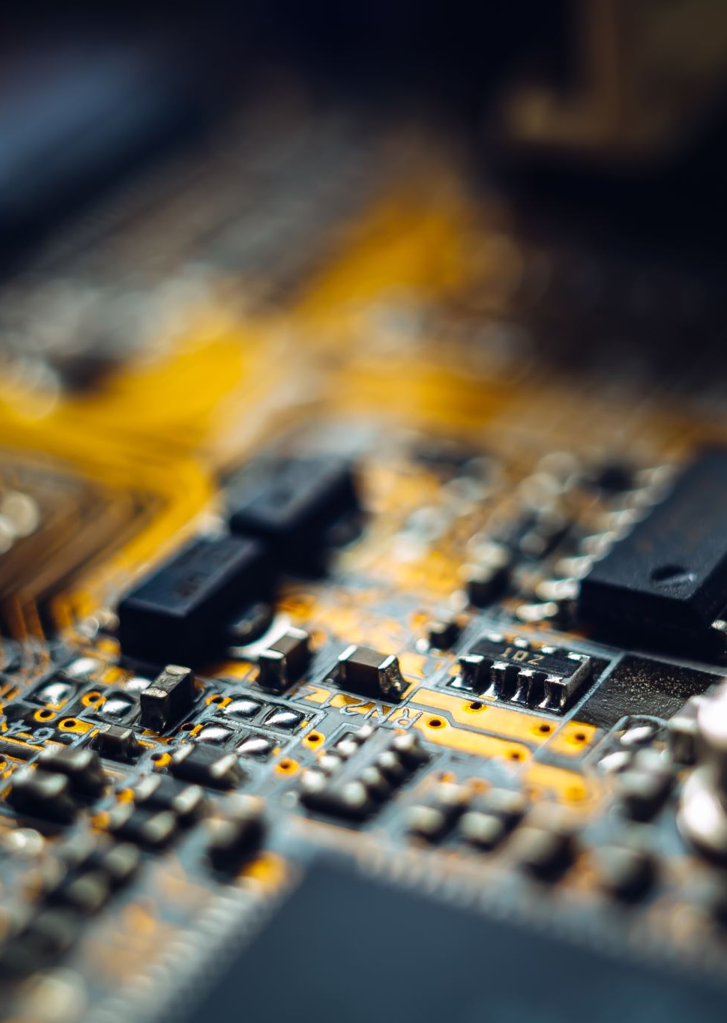
Software and Hardware Requirements:
Face_recognition
numpy
Opencv-python
os
power shell
i3 processor
cmake

Slide 8
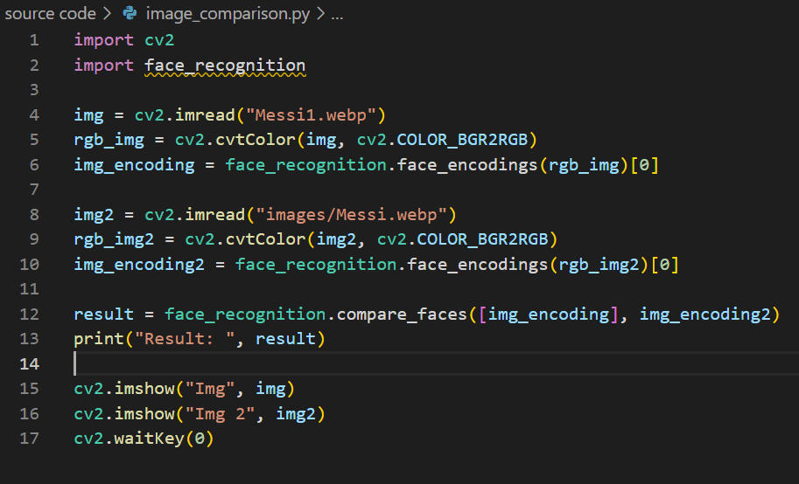
Code:
The main code is given in the picture and there are other programs to implement the running of the application.

Slide 9
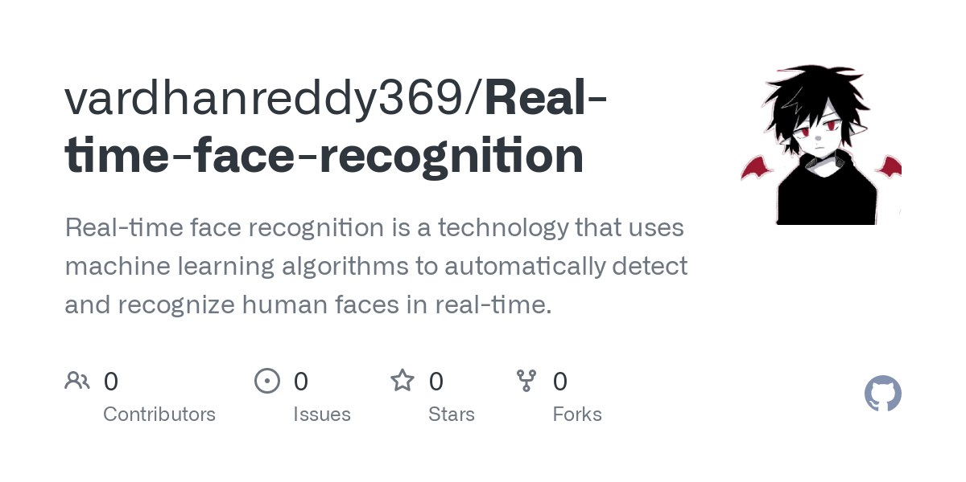
GitHub setup:
https://github.com/vardhanreddy369/Real-time-face-recognition

Slide 10
Thank you

